Slide 1

Library Management System
This project and presentation for partial fulfillment of
Problem Solving Using Python Programming
Sanchita 2210992245
Sania 2210992246
SUPERVISER
Dr. Shubham Gargrish
INSTITUTE OF ENGINEERING AND TECHNOLOGY
Department of Computer Science and Engineering
CHITKARA UNIVERSITY

Slide 2

Library Management System
It kills you…
Reach your GOAL , before it kicks you…
Live the LIFE , before it leaves you…
Get READY , we will help you…

Slide 3
Outline
Introduction
Objective
Aim
Problem statement
Advantages
Limitiations of project
Conclusions
Recommendations
Appendix
Results and analysis
Reference

Slide 4

Introduction
# Brain power institute that provides teaching class for students.
# The institute is an invaluable source for students , researchers
and facility of EDUCATION industry.
# The institute is established at 20th march,1992.
RESEARCH
CONSULTING
TRAINING
LEARNING REQUIREMENT
TEACHING

Slide 5

Objectives of the project
Basic objective
More accuracy
Speed improvement
Data inconsistency
Better error handling
Integrity
Other objectives
The system will handle the maintenance of data.
It handle entire transaction of book registration till issue of the book.
Administrator will immediately acknowledged with error message.
The administrator details of books , authors and existing member etc.
Book wise search can be performed

Slide 6

Our Aim
Students can easily take and issue books.
Students delight by delivering on-time
and fast service.
3. Maintain for generating various reports

Slide 7

Problem statement
Many books are available and to sort them in genres and find the one we like is a tedious job
Therefore, the book recommendation system sets up the whole display of books and users can easily select their genre and the book as per their likings.
User can select the genres from their devices as per their choice. Books under the same genre will be displayed online, after selecting the book, its description and link to buy it will be shown on screen

Slide 8
Advantages
1. This project can be used for any company , for finite number of products , and for finite number of
categories as it is totally generic.
2. The data of the member would be entered in the database.
3. There would be a safe storage of information of the member in the database.
4. Quick , easy , flexible generation of the member reports.
5. There would be dynamic and fully computerized system would be developed.
6. With the database any data can be added , modified , deleted very quickly.
7. Security features are very much provided in the system.
8. User friendly environment.

Slide 9
Limitations of project
Limited books on display.
Can select only one book at a time.
Only core genres of books are available.
Cover of the books not available.
Might face network issue while ordering the book.
The book recommended may not always be the one user is looking for.

Slide 10
Conclusions
This system is used for recommending books to users based on their interest . The user has to select the genre of the book and the books under that genre will be displayed. The user can select the book and read the description of the selected book and check its rating which is taken from good-reads. The link to buy the book from amazon is also given and thus the user can order the book and enjoy reading it, saving plenty of time, instead of surfing the internet to find a perfect read.
It can be concluded that it saves time and provides user with quality content. The proposed system would attract readers and adds to the efficiency of sorting of books and maintaining a record.

Slide 11
Recommendations
This will save time of user in searching online for their choice of genre and books under that.
It helps in sorting of books under similar interests.
Recommender systems are really critical in some industries as they can generate a huge amount of income when they are efficient.

Slide 12
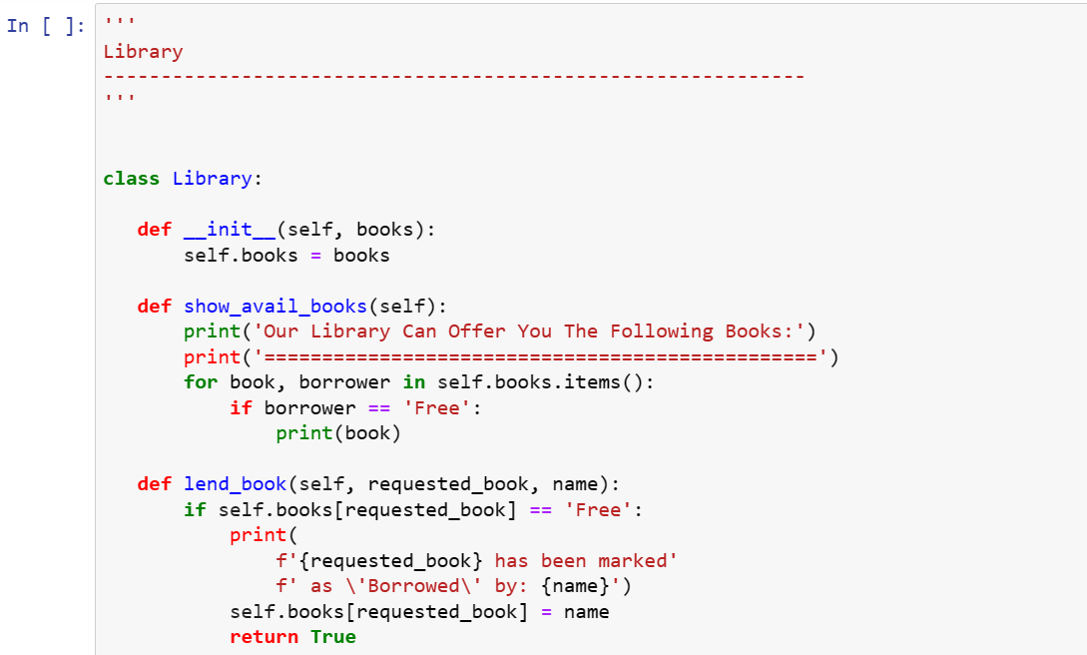
Appendix

Slide 13
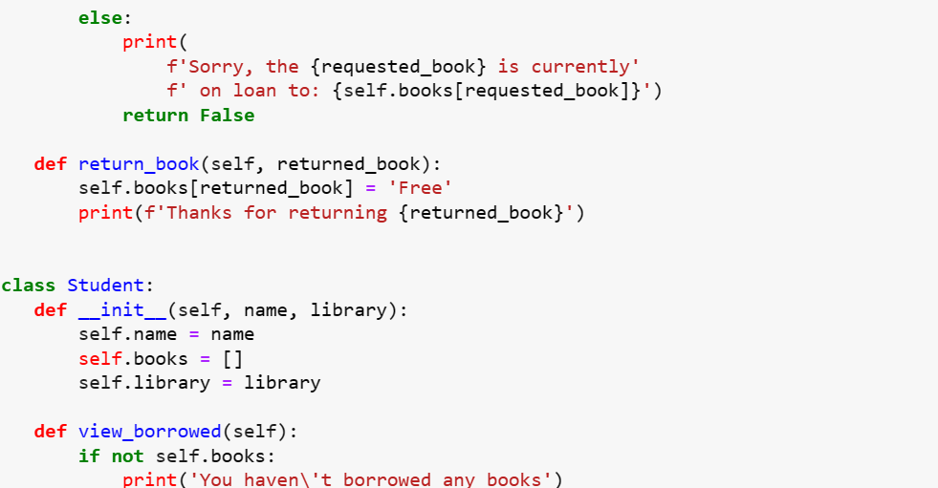

Slide 14
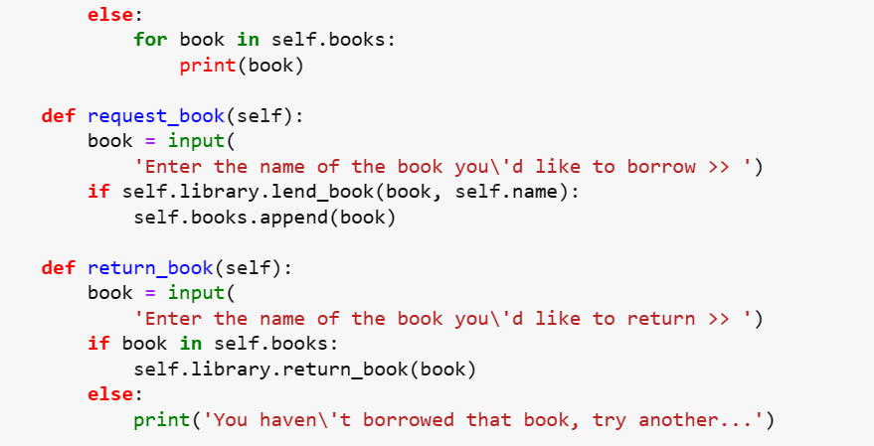

Slide 15
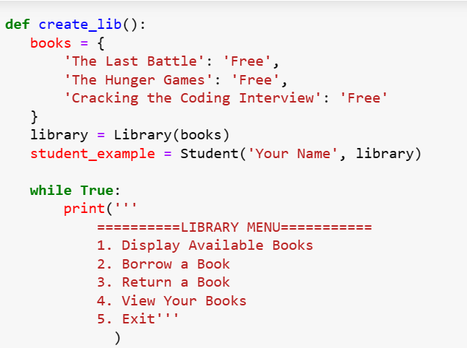

Slide 16
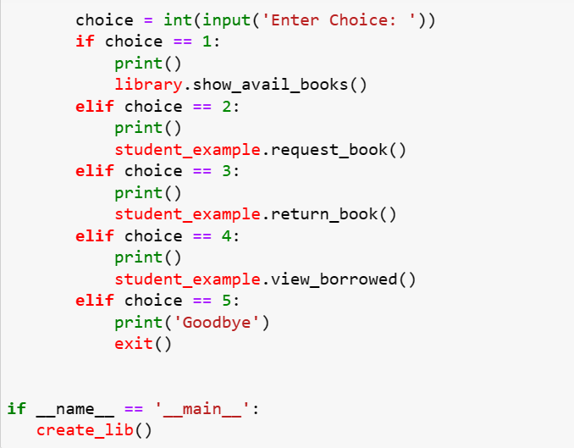

Slide 17
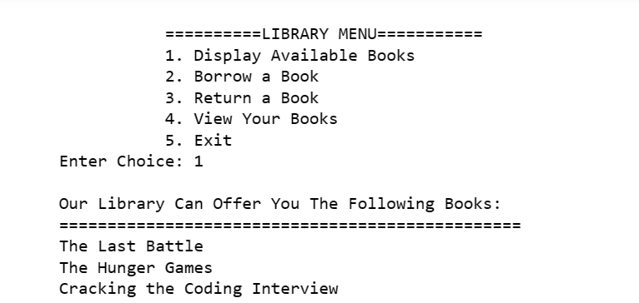
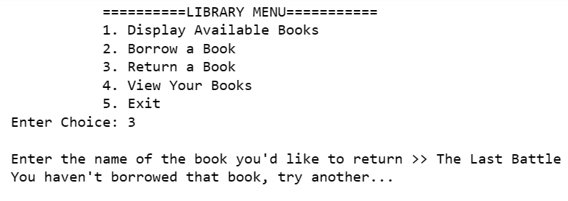
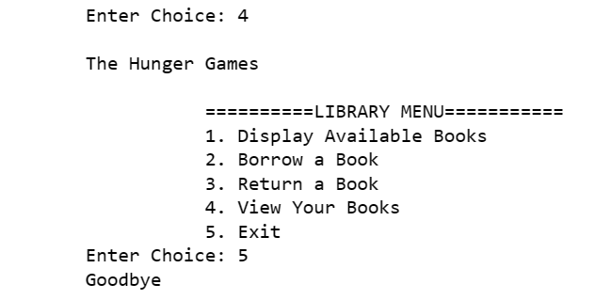
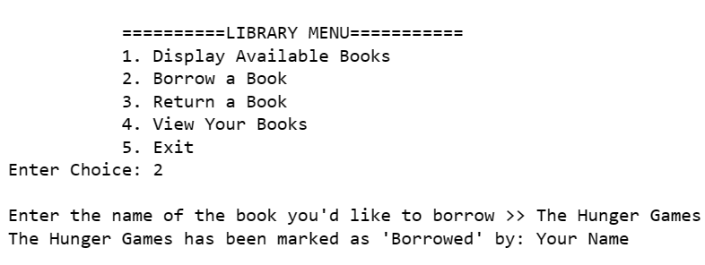
Results and Analysis

Slide 18
Reference
YOUTUBE: www.youtube.com//codewithharry
freecodecamp.org
GOOGLE: www.Geekforgeeks.com

Slide 19
THANKYOU!

